Slide 1
Revisiting Java

Slide 2
Java Basics
History of Java
Platform Independency in Java
USP of Java: Java Features
Sun-Oracle Deal
Different Java Platforms
Difference between JDK,JRE,JVM
Java Versions
JVM Architecture
Installing Java on Windows
Understanding Path Variable: Why Set Path

Slide 3
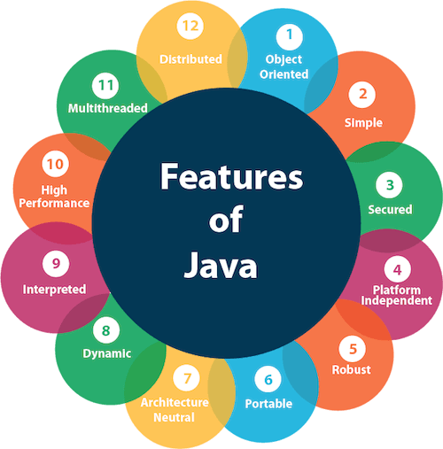

Slide 4
Secure
Java has Security Manager concept, which keeps its execution within a Sandbox to prevent any harm to the system it is running on.
No buffer-overflow exploits : It cannot store data outside its fixed length memory boundary
Byte-code verification
Security-related APIs
Stack corruption : Stack corruption is a phenomenon in which some memory locations at stack are accessed unintentionally due to wrong coding leading to change in values at those memory locations. Since the data corruption happens on stack memory locations, hence the term Stack Corruption.
No pointers
JVM here is responsible to manage this security.

Slide 5
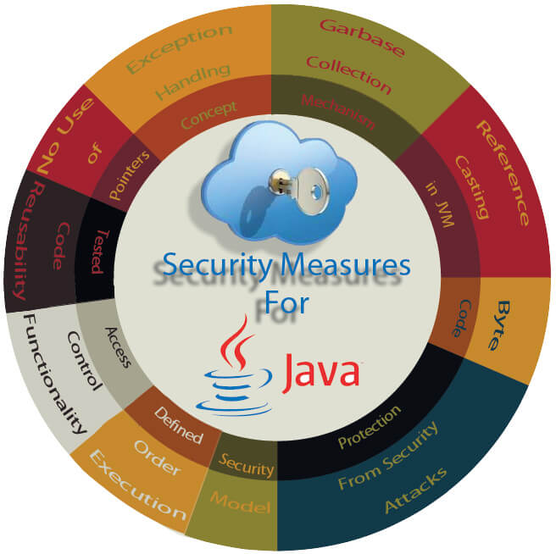

Slide 6

Robust
Java is Robust because it is highly supported language. It has certain features which justify this feature
Automatic Memory Management (GC)
Strong Type Checking
Exception Handling Mechanism
No Multiple Inheritance Concept
JVM Controlled Execution

Slide 7
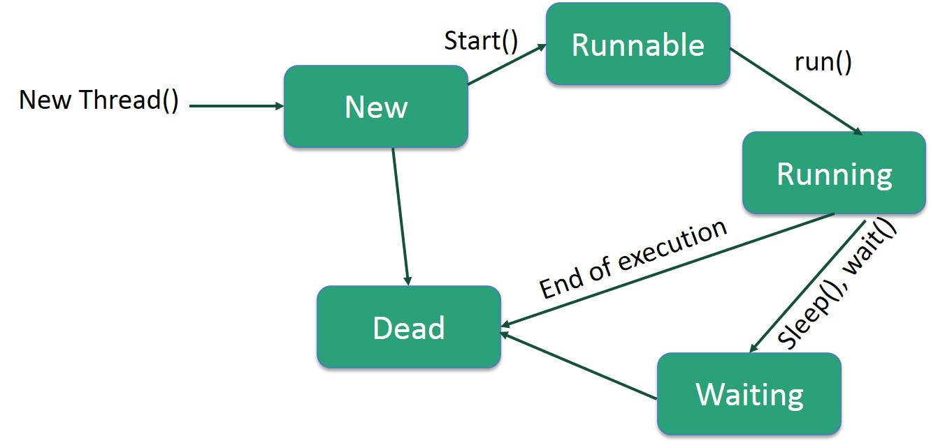
Multithreaded
Multithreading is a Java feature that allows concurrent execution of two or more parts of a program for maximum utilization of CPU. Each part of such program is called a thread. So, threads are light-weight processes within a process. We create a class that extends the java.

Slide 8
High in Performance
Java enabled High performance by introducing JIT- Just In Time compiler , JIT helps the compiler to compile the code On demand basis i.e which ever method is called only that method block will get compiled making compilation fast and time-efficient. This makes the java delivering high performance.

Slide 9
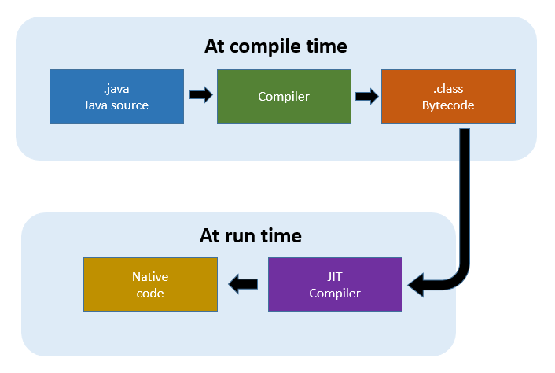

Slide 10
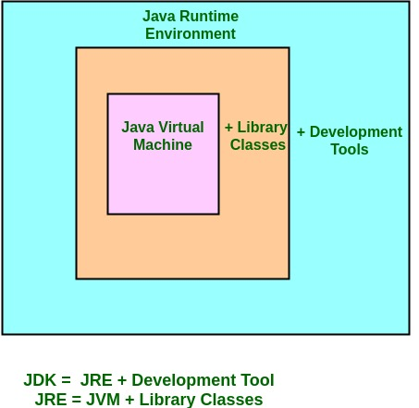
JDK, JRE, JVM

Slide 11
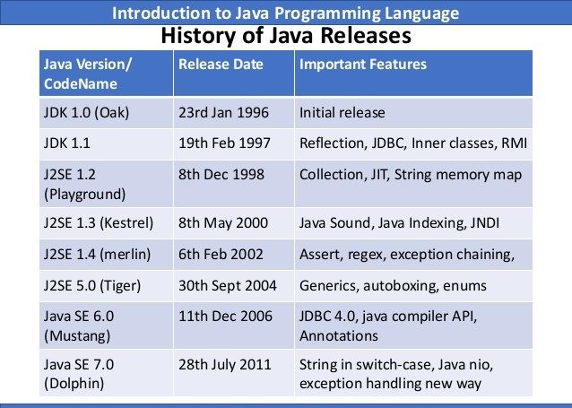
Java Versions

Slide 12
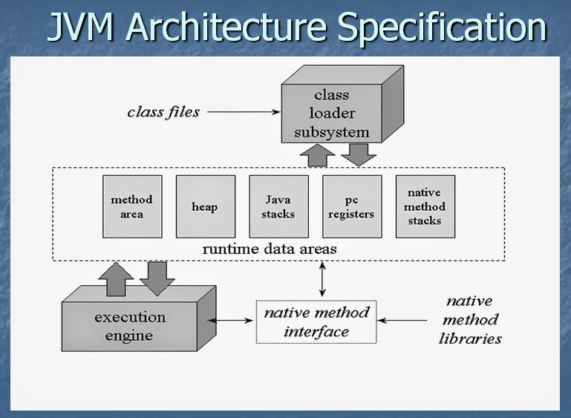

Slide 13
The JVM resides on the RAM. During execution, using the Class Loader subsystem, the class files are brought on to the RAM. This is called Java’s dynamic class loading functionality. It loads, links, and initializes the class file (.class) when it refers to a class for the first time at runtime (not compile time).

Slide 14
Runtime Data Area
Runtime Data Areas are the memory areas assigned when the JVM program runs on the OS. In addition to reading .class files, the Class Loader subsystem generates corresponding binary data and save the following information in the Method area for each class separately

Slide 15
Method Area (Shared among Threads)
This is a shared resource (only 1 method area per JVM). All JVM threads share this same Method area, so the access to the Method data and the process of dynamic linking must be thread safe.

Slide 16
Heap Area (Shared among Threads)
This is also a shared resource (only 1 heap area per JVM). Information of all objects and their corresponding instance variables and arrays are stored in the Heap area. Since the Method and Heap areas share memory for multiple threads, the data stored in Method & Heap areas are not thread safe. Heap area is a great target for GC.

Slide 17
Stack Area (per Thread)
This is not a shared resource. For every JVM thread, when the thread starts, a separate runtime stack gets created in order to store method calls. For every such method call, one entry will be created and added (pushed) into the top of runtime stack and such entryit is called a Stack Frame.

Slide 18
PC Registers (per Thread)
For each JVM thread, when the thread starts, a separate PC (Program Counter) Register gets created in order to hold the address of currently-executing instruction (memory address in the Method area). If the current method is native then the PC is undefined. Once the execution finishes, the PC register gets updated with the address of next instruction.

Slide 19
Native Method Stack (per Thread)
There is a direct mapping between a Java thread and a native operating system thread. After preparing all the state for a Java thread, a separate native stack also gets created in order to store native method information (often written in C/C++) invoked through JNI (Java Native Interface).
Once the native thread has been created and initialized, it invokes the run()method in the Java thread. When the run() method returns, uncaught exceptions (if any) are handled, then the native thread confirms whether the JVM needs to be terminated as a result of the thread terminating (i.e. is it the last non-deamon thread). When the thread terminates, all resources for both the native and Java threads are released.

Slide 20
Execution Engine
The actual execution of the bytecode occurs here. Execution Engine executes the instructions in the bytecode line-by-line by reading the data assigned to above runtime data areas.

